Slide 1
Theory Of Automata
LECTURE 35 & 36
NON-DETERMINISTIC PUSHDOWN AUTOMATA
(NPDA)
Instructor: Sulaman Ahmad Naz

Slide 2


Important Remarks!!!
It is not compulsory to include a REJECT state as we cannot escape from a dead-end state in FA’s.
Similarly, if we cannot escape the ACCEPT state once entered, we don’t need to read all the input letters.

Slide 3



Example
Let the R.E of a language: a(a+b)*
START
READ
READ
ACCEPT
REJECT

Slide 4
Example
Let the R.E of a language: a(a+b)*
START
READ
READ
ACCEPT

Slide 5
Example
Let the R.E of a language: a(a+b)*
START
READ
ACCEPT
-
+

Slide 6
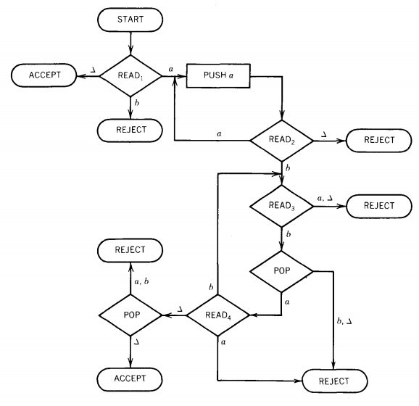
Task 1
Show that the following strings are accepted or not:
abb
abab
aabb
aabbbb
What is the language accepted and give CFG.

Slide 7
Solution
{a^{n}b^{2n}}

Slide 8
Solution
S → Λ
S → aSbb

Slide 9
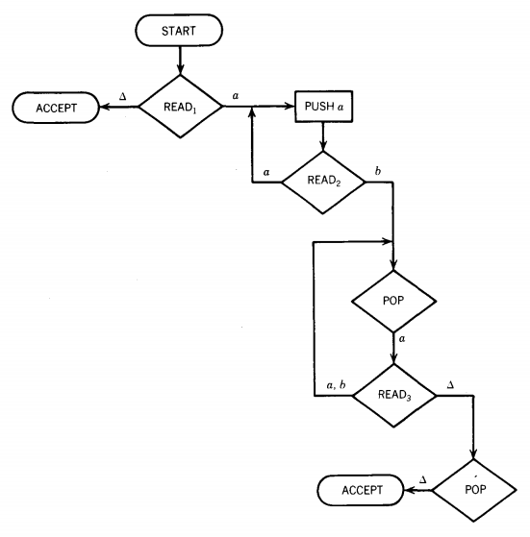
Task 2
Show that the following strings are accepted or not:
aaabbb
aaabab
aaabaa
aaaabb
What is the language accepted.

Slide 10
Solution
The language of all string starting with some a’s (if any) followed by any combination of same number of characters starting with a “b”.

Slide 11
Task 3(a)
A PDA contains only one stack and can be used to accept.
{a^{n}b^{n}}
However, {a^{n}b^{n}a^{n} : n>0} cannot be accepted by a PDA as it is a context-sensitive language.
Construct a special type of PDA with two stacks to accept it.

Slide 12
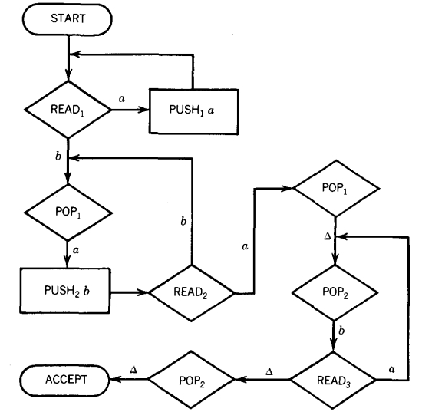
Solution

Slide 13
Task 3(b)
Construct a special type of PDA with two stacks to accept
{a^{n}b^{n}a^{n}}

Slide 14

Solution
There is a minor mistake
intentionally kept for you
to indicate & correct.
START
READ
READ
POP S₁
POP S₂
PUSH S₂ b
POP S₁
PUSH S₁ a
READ
POP S₁
ACCEPT
POP S₂
4

Slide 15
Practice Question 2
Lecture 34
Construct a PDA for the following Language.
ODDDPALINDROME
The words in this language are:
{ a, b, aaa, aba, bab, bbb, ... }

Slide 16
Solution
ODDPALINDROME cannot be constructed
Using Deterministic PDAs.
We need a NPDA for this language.

Slide 17
DETERMINISM vs. NONDETERMINISM
A deterministic PDA is one for which every input string has a unique path through the machine.
A nondeterministic PDA is one for which at certain times we may have to choose among possible paths through the machine.
We say that an input string is accepted by such a machine if some set of choices leads us to an ACCEPT state.
If for all possible paths that a certain input string can follow it always ends at a REJECT state, then the string must be rejected.

Slide 18
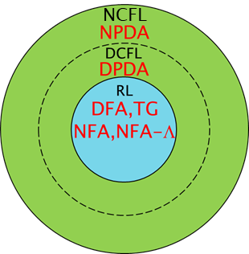
POWER SUMMARY

Slide 19

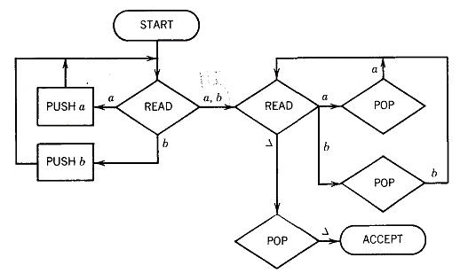
Solution

Slide 20
Task 4
Show that the input string “abbabba” is accepted by the following machine.

Slide 21
Solution
∆
∆
∆
∆
∆
∆
∆
∶
abbabba∆∆∆∆∆…

Slide 22
Solution
a
∆
∆
∆
∆
∆
∆
∶
abbabba∆∆∆∆∆…

Slide 23
Solution
b
a
∆
∆
∆
∆
∆
∶
bbabba∆∆∆∆∆…

Slide 24
Solution
b
b
a
∆
∆
∆
∆
∶
babba∆∆∆∆∆…

Slide 25
Solution
b
b
a
∆
∆
∆
∆
∶
abba∆∆∆∆∆…

Slide 26
Solution
b
a
∆
∆
∆
∆
∆
∶
bba∆∆∆∆∆…

Slide 27
Solution
a
∆
∆
∆
∆
∆
∆
∶
ba∆∆∆∆∆…

Slide 28
Solution
∆
∆
∆
∆
∆
∆
∆
∶
a∆∆∆∆∆…

Slide 29
Solution
∆
∆
∆
∆
∆
∆
∆
∶
∆∆∆∆∆…

Slide 30
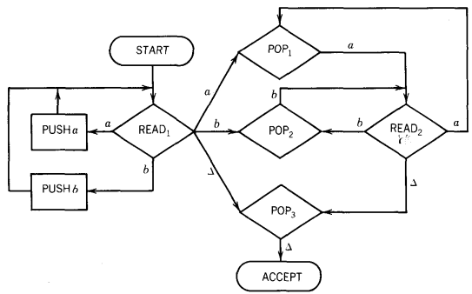
Practice Question
What is the language recognized by the following PDA.

Slide 31

Construction of NPDA
It is very easy to construct NPDA for any CFG if it is in CNF.
Proof of Theorem 28 proposes a constructive algorithm for this purpose.

Slide 32
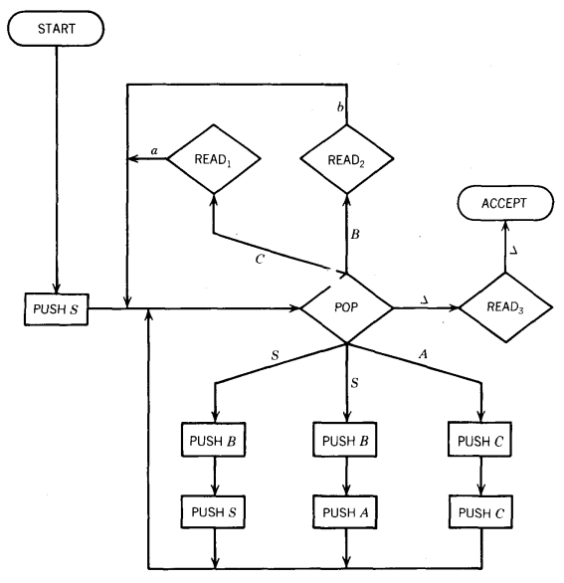

Example

Slide 33
Example
a | a | b | b | ∆ | ∆ | ...
∆
∆
∆
∆
∆
∆
∆
∶

Slide 34
Example
a | a | b | b | ∆ | ∆ | ...
S
∆
∆
∆
∆
∆
∆
∶
S

Slide 35
Example
a | a | b | b | ∆ | ∆ | ...
∆
∆
∆
∆
∆
∆
∆
∶
S

Slide 36
Example
a | a | b | b | ∆ | ∆ | ...
S
B
∆
∆
∆
∆
∆
∶
S
S
B

Slide 37
Example
a | a | b | b | ∆ | ∆ | ...
B
∆
∆
∆
∆
∆
∆
∶
S
S
B

Slide 38
Example
a | a | b | b | ∆ | ∆ | ...
A
B
B
∆
∆
∆
∆
∶
S
S
B
A
B

Slide 39
Example
a | a | b | b | ∆ | ∆ | ...
B
B
∆
∆
∆
∆
∆
∶
S
S
B
A
B

Slide 40
Example
a | a | b | b | ∆ | ∆ | ...
C
C
B
B
∆
∆
∆
∶
S
S
B
A
B
C
C

Slide 41
Example
a | a | b | b | ∆ | ∆ | ...
C
B
B
∆
∆
∆
∆
∶
S
S
B
A
B
C
C

Slide 42
Example
a | a | b | b | ∆ | ∆ | ...
C
B
B
∆
∆
∆
∆
∶
S
S
B
A
B
C
C
a

Slide 43
Example
a | a | b | b | ∆ | ∆ | ...
B
B
∆
∆
∆
∆
∆
∶
S
S
B
A
B
C
C
a

Slide 44
Example
a | a | b | b | ∆ | ∆ | ...
B
B
∆
∆
∆
∆
∆
∶
S
S
B
A
B
C
C
a
a

Slide 45
Example
a | a | b | b | ∆ | ∆ | ...
B
∆
∆
∆
∆
∆
∆
∶
S
S
B
A
B
C
C
a
a

Slide 46
Example
a | a | b | b | ∆ | ∆ | ...
B
∆
∆
∆
∆
∆
∆
∶
S
S
B
A
B
C
C
b
a
a

Slide 47
Example
a | a | b | b | ∆ | ∆ | ...
∆
∆
∆
∆
∆
∆
∆
∶
S
S
B
A
B
C
C
b
a
a

Slide 48
Example
a | a | b | b | ∆ | ∆ | ...
∆
∆
∆
∆
∆
∆
∆
∶
S
S
B
A
B
b
C
C
b
a
a

Slide 49
Example
a | a | b | b | ∆ | ∆ | ...
∆
∆
∆
∆
∆
∆
∆
∶
S
S
B
A
B
b
C
C
b
a
a

Slide 50
Example
a | a | b | b | ∆ | ∆ | ...
∆
∆
∆
∆
∆
∆
∆
∶
S
S
B
A
B
b
C
C
b
a
a

Slide 51
Example
a | a | b | b | ∆ | ∆ | ...
∆
∆
∆
∆
∆
∆
∆
∶
S
S
B
A
B
b
C
C
b
a
a

Slide 52

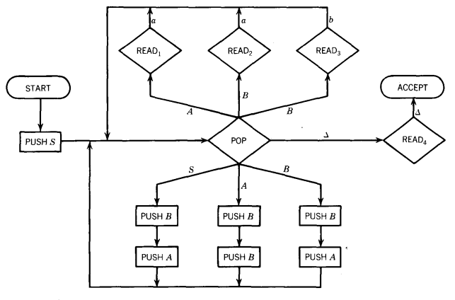
Example

Slide 53
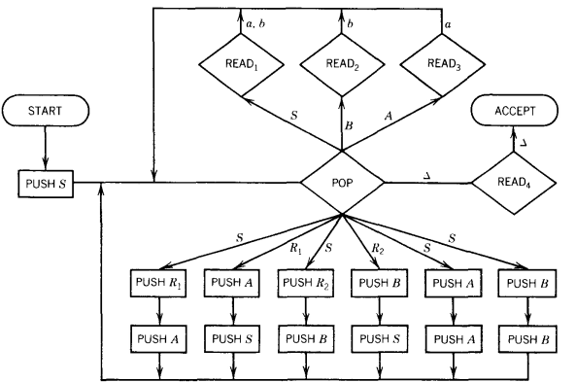
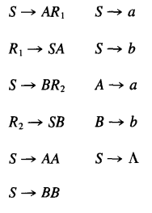
Example

Slide 54
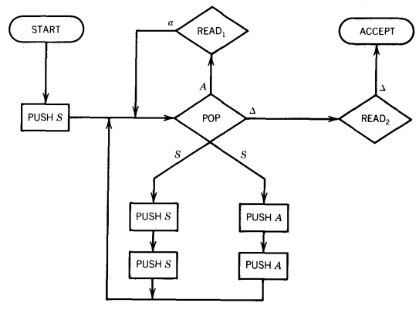

Example

Slide 55
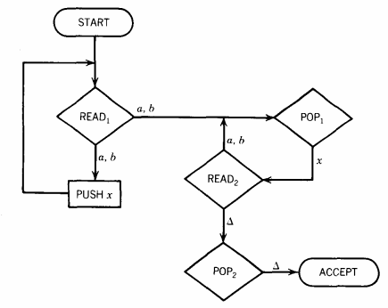
Task 5
Show that the following strings are accepted or not:
ab
bbba
What is the language accepted and give CFG and an equivalent FA.

Slide 56
Task 5
The language of all string having an even length, not including Λ

Slide 57
Task 5
S → XX
S → XXS
X → a | b

Slide 58
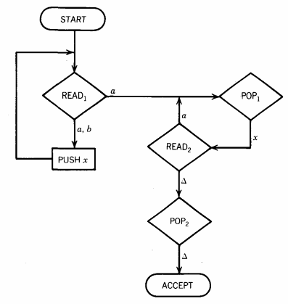
Task 6
Show that the following strings are accepted or not:
aa
babaaa
babaaab
babaaaa
What is the language accepted and give CFG.

Slide 59
Task 6
The language of all string in which any substring is followed by a^{n} where n is the length of preceded substring, not including Λ

Slide 60
Task 6
S → Xa
S → XSa
X → a | b

Slide 61
Practice Question
Build a PDA to accept the language:
{a^{n}b^{n+1}: n=1,2,3,…}

Slide 62
Practice Question
Let Σ={a,b,c} and L be the language of all words in which all a’s come before the b’s and they are equal in number while there is no restriction for c’s. Find a PDA that accepts L and a CFG to generate it.

Slide 63
Task 7
Let L be the language of balanced parenthesis (as in arithmetic expressions, which may be nested). Some words of the language are:
()
(())
()()()
(()()(()))
etc.
Find a PDA and CFG for L.

Slide 64
Solution
S → SS
S → LSR
S → LR
L → (
R → )
S → SS
S → LT
S → LR
L → (
R → )
T → SR

Slide 65
Solution
( )
READ
READ
ACCEPT
START
L R
POP
READ
PUSH S
S
T
S → SS
S → LT
S → LR
L → (
R → )
T → SR
S
S
PUSH S
PUSH T
PUSH R
PUSH R
PUSH S
PUSH L
PUSH L
PUSH S

Slide 66
Thanks
End of Lecture
Q/A

